Slide 1

FUNDRAISING ANALYSIS
ONIDOMA MATTHIAS C.

Slide 2
INTRODUCTION
the Head of Fundraising FOR CHARITY, EDUCATION FOR ALL ,ASKED MY TEAM to present the data on donor insights and donation rates.
objectives OF THE FUNDRAISING TEAM are to:
• Increase the number of donors in your database
• Increase the donation frequency of your donors.
• Increase the value of donations in your database.

Slide 3
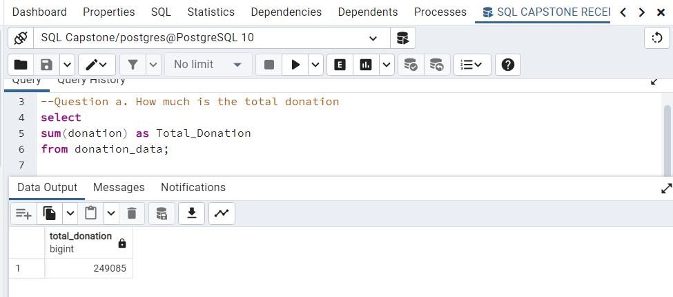
INSIGHTS
THE FOLLOWING ARE insights from the donation data to inform THE fundraising strategy and increase donations.
The total donation realized =$249,085

Slide 4
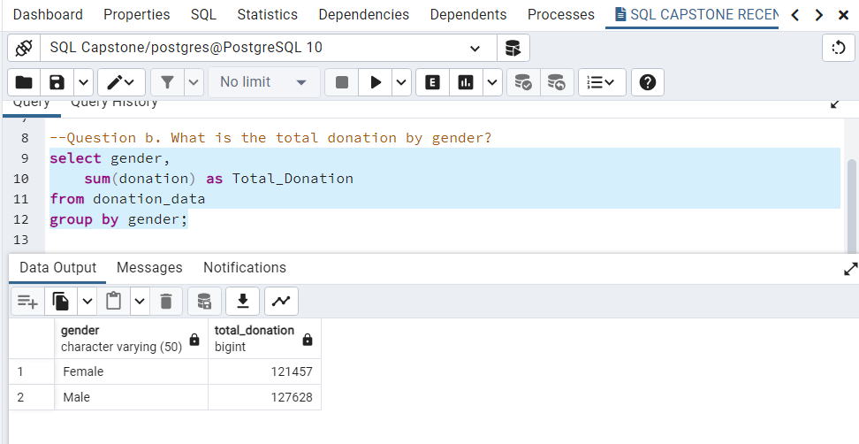
INSIGHTS
female donation = $121,457
Male donation =$127,628

Slide 5
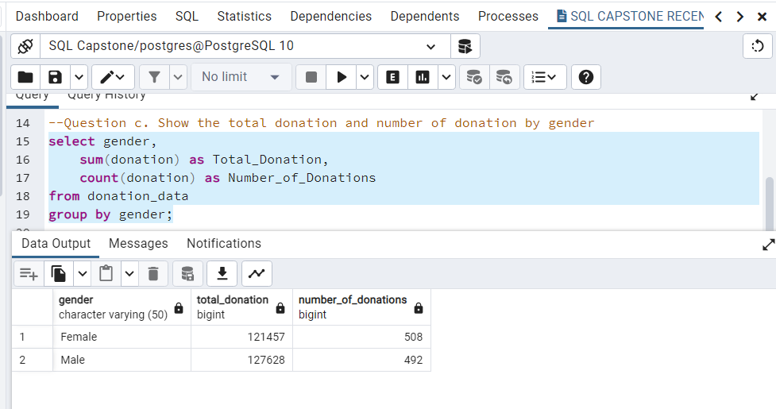
INSIGHTS

Slide 6
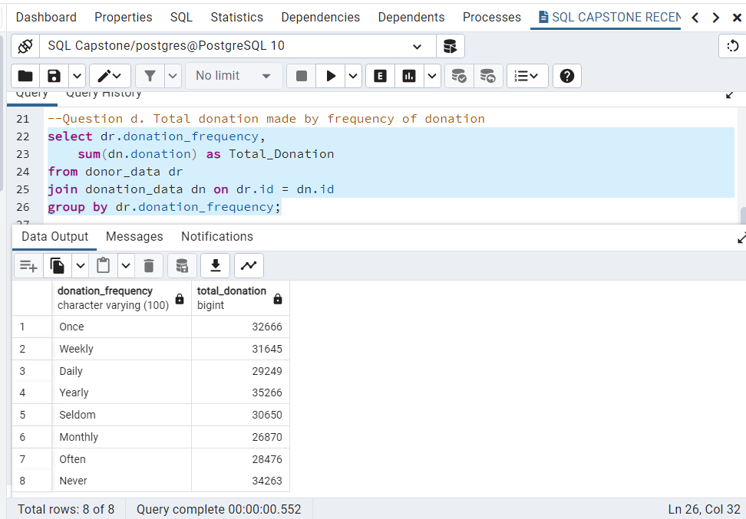
INSIGHTS

Slide 7
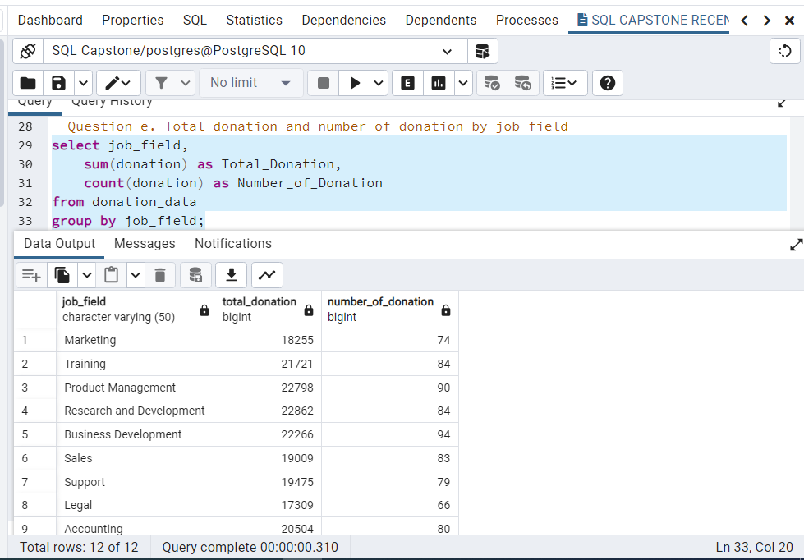
INSIGHTS

Slide 8
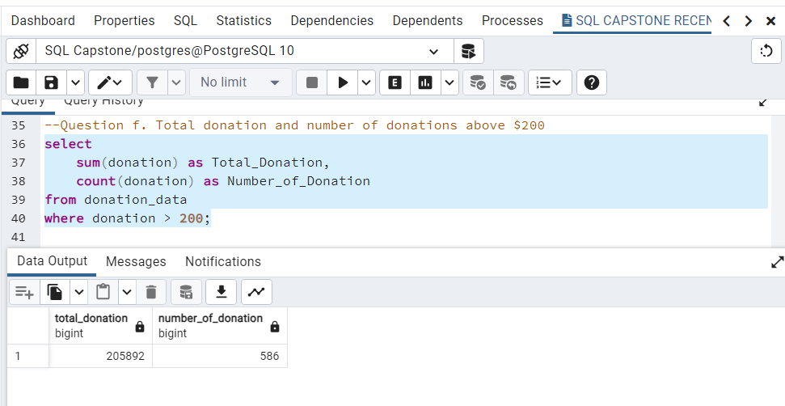
INSIGHTS

Slide 9
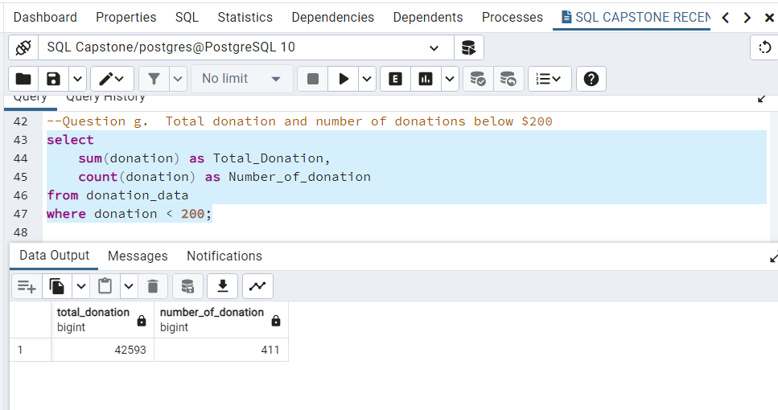
INSIGHTS

Slide 10
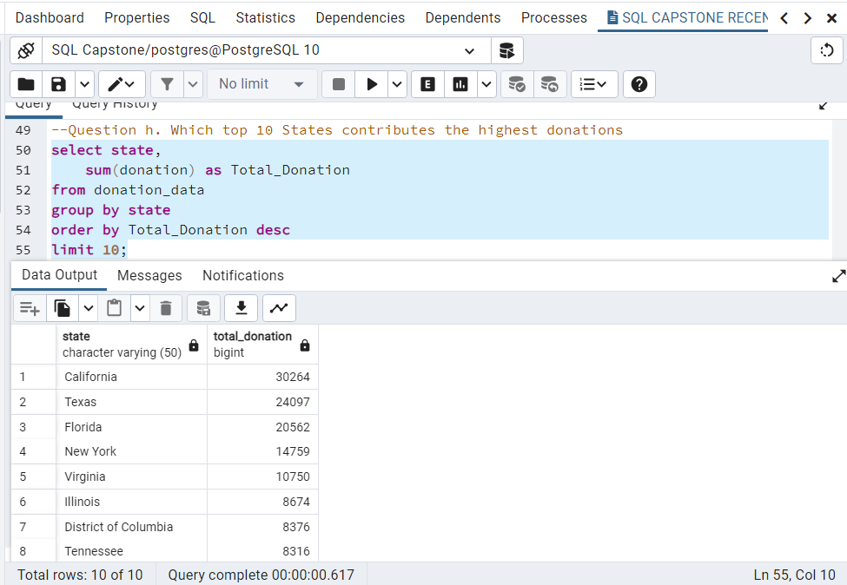
INSIGHTS

Slide 11
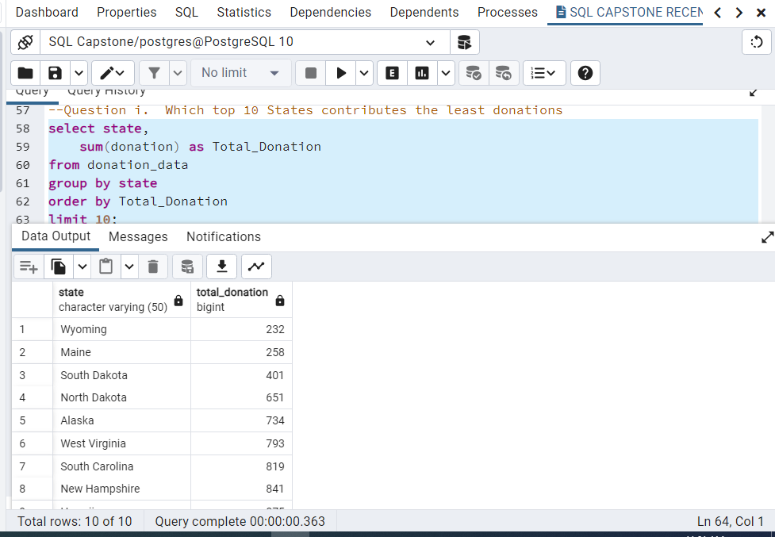
INSIGHTS

Slide 12
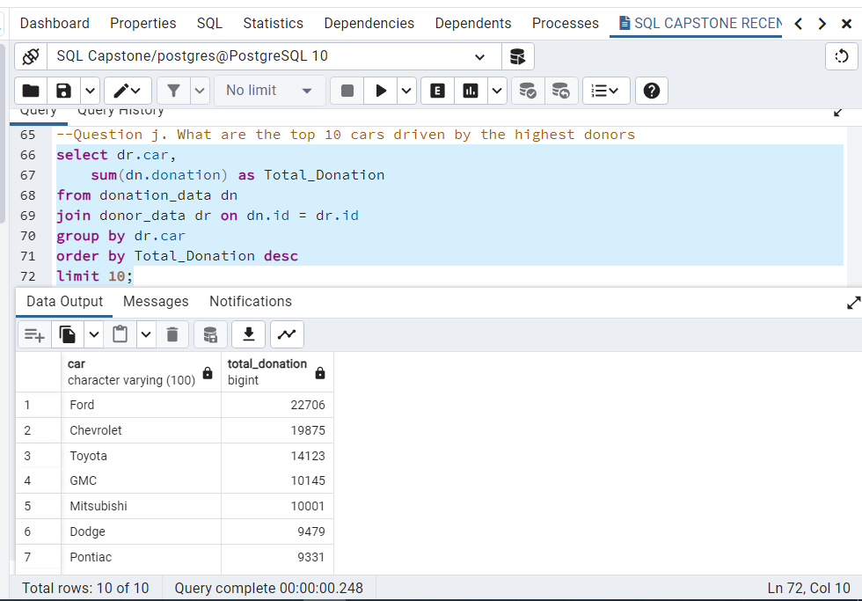
INSIGHTS

Slide 13
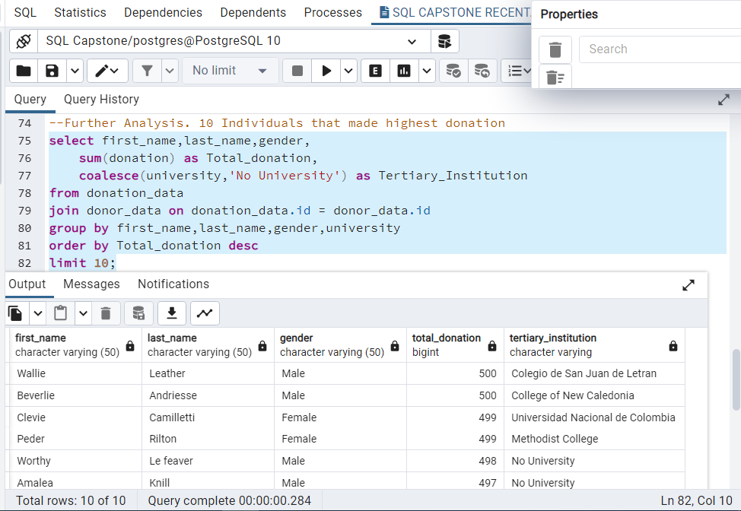
INSIGHTS

Slide 14
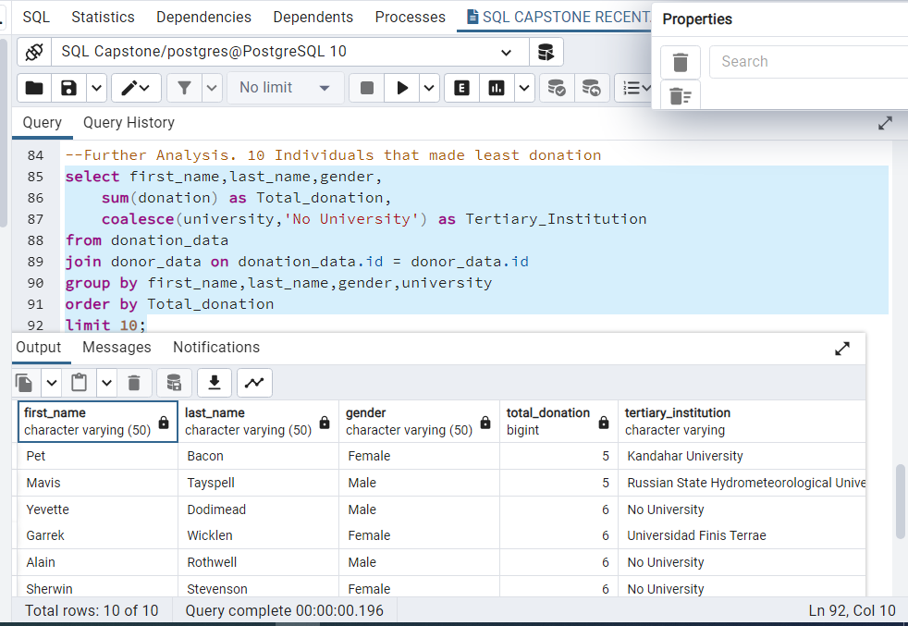
INSIGHTS

Slide 15
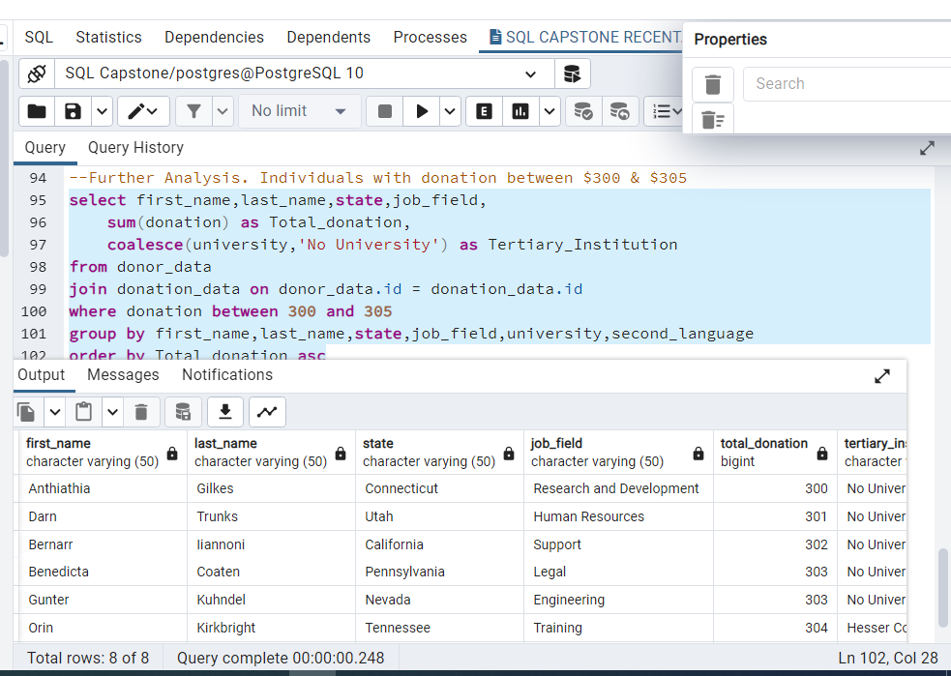
INSIGHTS

Slide 16
RECOMMENDATION
To increase the number donors, CHARITY, EDUCATION FOR ALL should create more awareness about their activities, more importantly on how they utilize the donations.
The management should replicate the strategies been used in states like California, Texas, florida (with higher donation) in low donation states like Wyoming, maine, south & north Dakota.
Although the number of donations made by females is more than males, the total donation from the female gender is lower than that of the male. To increase the value of donations, the female gender should be encouraged to improve the value of their donation.

